Slide 1

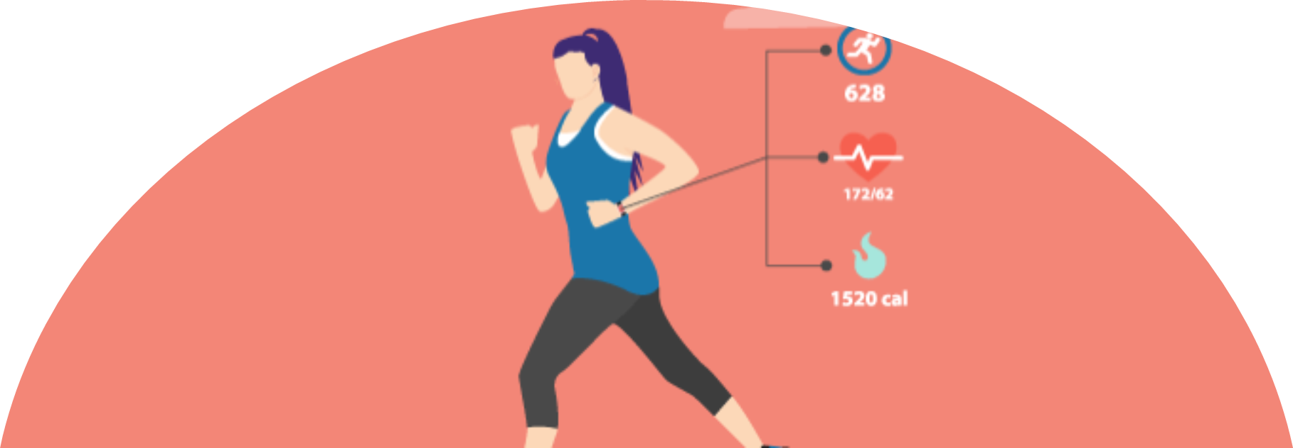
CALORIE BURNT PREDICTION -Design presentation
21311A05D2-Dondula Yashasvini
21311A05H9-Devireddy Nandini
21311A05G2- Mohammed Taqreed Azam
III-CSE-C
Batch 12

Slide 2
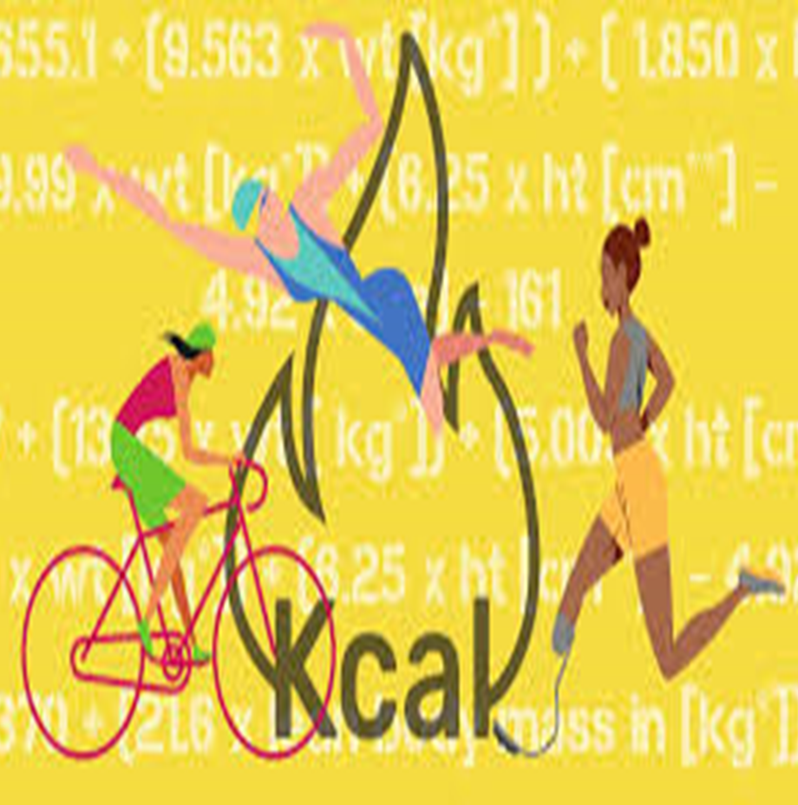
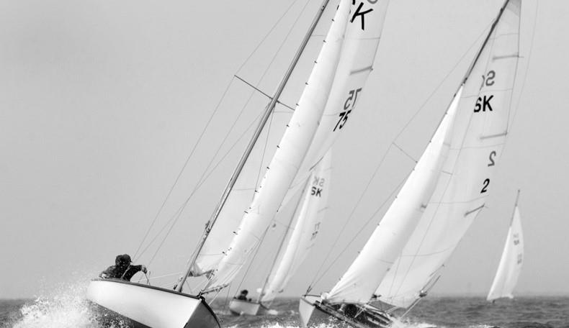

Contents
Introduction
Project flow
UML diagrams
Use case diagram
Class diagram
Sequence diagram
State chart diagram
Activity diagram
Software/hardware requirements

Slide 3
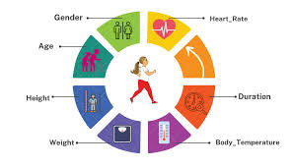
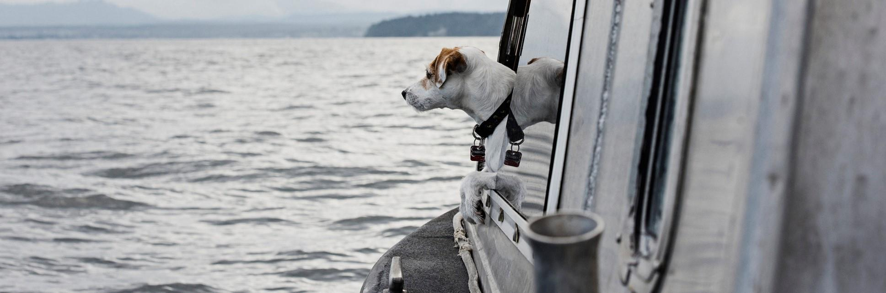
Introduction
The amount of calories burnt depends on internal and external factors, it is subjective and different for everyone depending on their height, weight, and fitness level [1]. Generally, people relate calories to weight or food reduction however it is a quantity of heat energy. From a human perspective, the number of calories is the amount of energy required to carry out a task. Different items have different calorie values related to them.As a human body performs some extensive activity or workout the body temperature and heart rate start rising which leads to the production of heat energy in the body. Which ultimately causes calories to burn. To show the same we take some input parameters such as age, gender, height, and weight and apply different regression algorithms such as linear regression, XG Boost regression, AdaBoost regression, SVR, Decision tree regression, and Random forest regression over the data to get the best and optimal results.

Slide 4
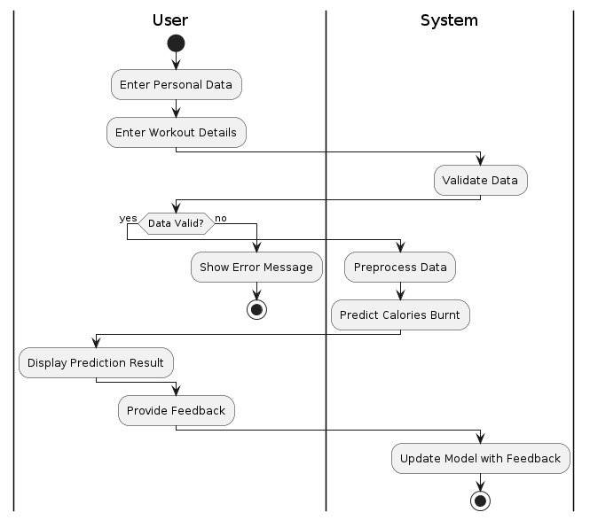
Project Flow
Regresssions | Mean absolute error
Linear regression | 8.3851
Decision tree regression | 3.343
Random forest regression | 1.675
Ada boost regression | 8.670
SVR | 10.620

Slide 5
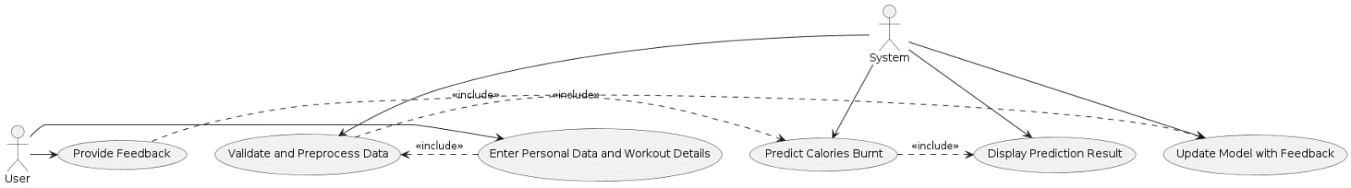
Use Case Diagram
Regresssions | Mean absolute error
Linear regression | 8.3851
Decision tree regression | 3.343
Random forest regression | 1.675
Ada boost regression | 8.670
SVR | 10.620

Slide 6
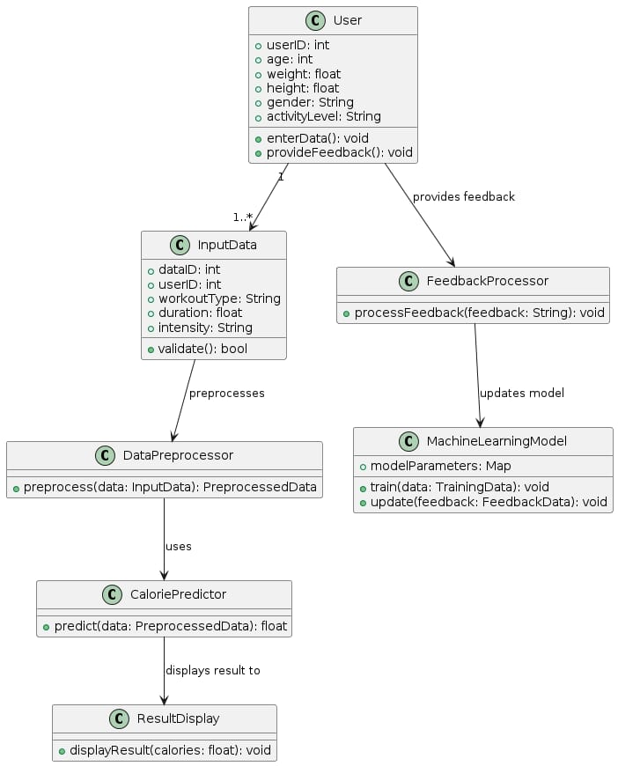
Class Diagram
Regresssions | Mean absolute error
Linear regression | 8.3851
Decision tree regression | 3.343
Random forest regression | 1.675
Ada boost regression | 8.670
SVR | 10.620

Slide 7
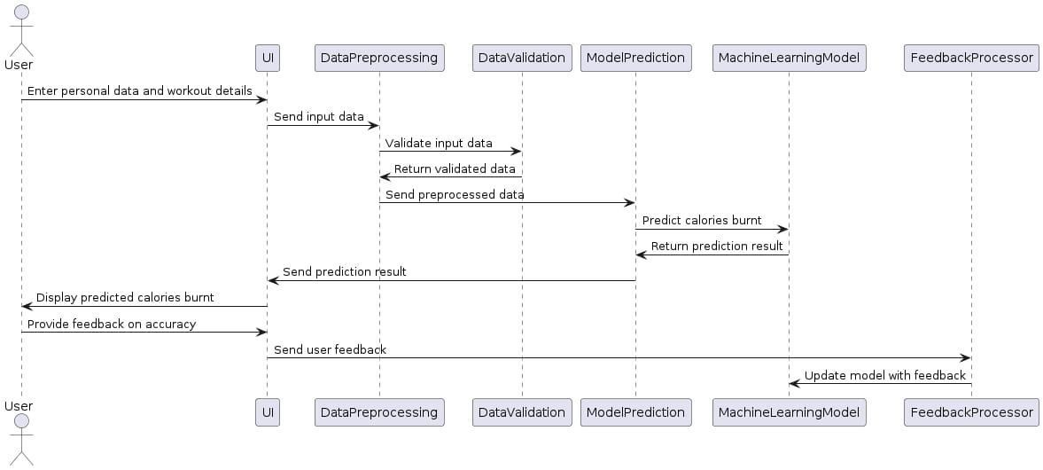
Sequence Diagram
Regresssions | Mean absolute error
Linear regression | 8.3851
Decision tree regression | 3.343
Random forest regression | 1.675
Ada boost regression | 8.670
SVR | 10.620

Slide 8
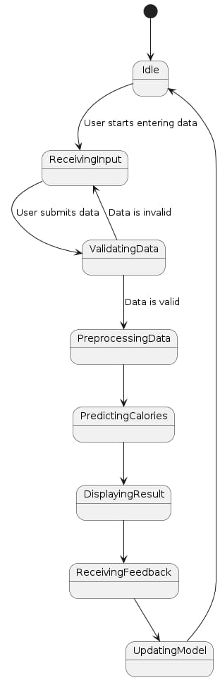
State Chart Diagram
Regresssions | Mean absolute error
Linear regression | 8.3851
Decision tree regression | 3.343
Random forest regression | 1.675
Ada boost regression | 8.670
SVR | 10.620

Slide 9
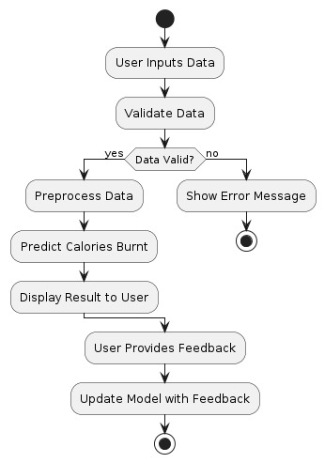
Activity Diagram
Regresssions | Mean absolute error
Linear regression | 8.3851
Decision tree regression | 3.343
Random forest regression | 1.675
Ada boost regression | 8.670
SVR | 10.620

Slide 10
Software & Hardware Requirements
Software
Hardware
1. Python Programming Language Environment
2. XGBoost Library
3. Pandas for Data Manipulation
4. NumPy for Numerical Operations
5. Scikit-learn for Machine Learning Utilities
6. Matplotlib or Seaborn for Visualization
7. Jupyter Notebook or JupyterLab for Interactive Development
8. Integrated Development Environment (IDE)
9. Version Control System (Optional)
10. Environment Management Tool (Optional)
1. Processor (CPU)
2. Memory (RAM)
3. Storage
4. Graphics Processing Unit (GPU) (optional)
5. Operating System
6. Internet Connection
7. Miscellaneous

Slide 11

Thank You

